Slide 1
Microsoft Power BI

Slide 2
Power BI Dev Camp – Session 2 Writing PowerShell Scripts for Power BI
Ted Pattison
Principal Program Manager
Customer Advisory Team (CAT) at Microsoft

Slide 3
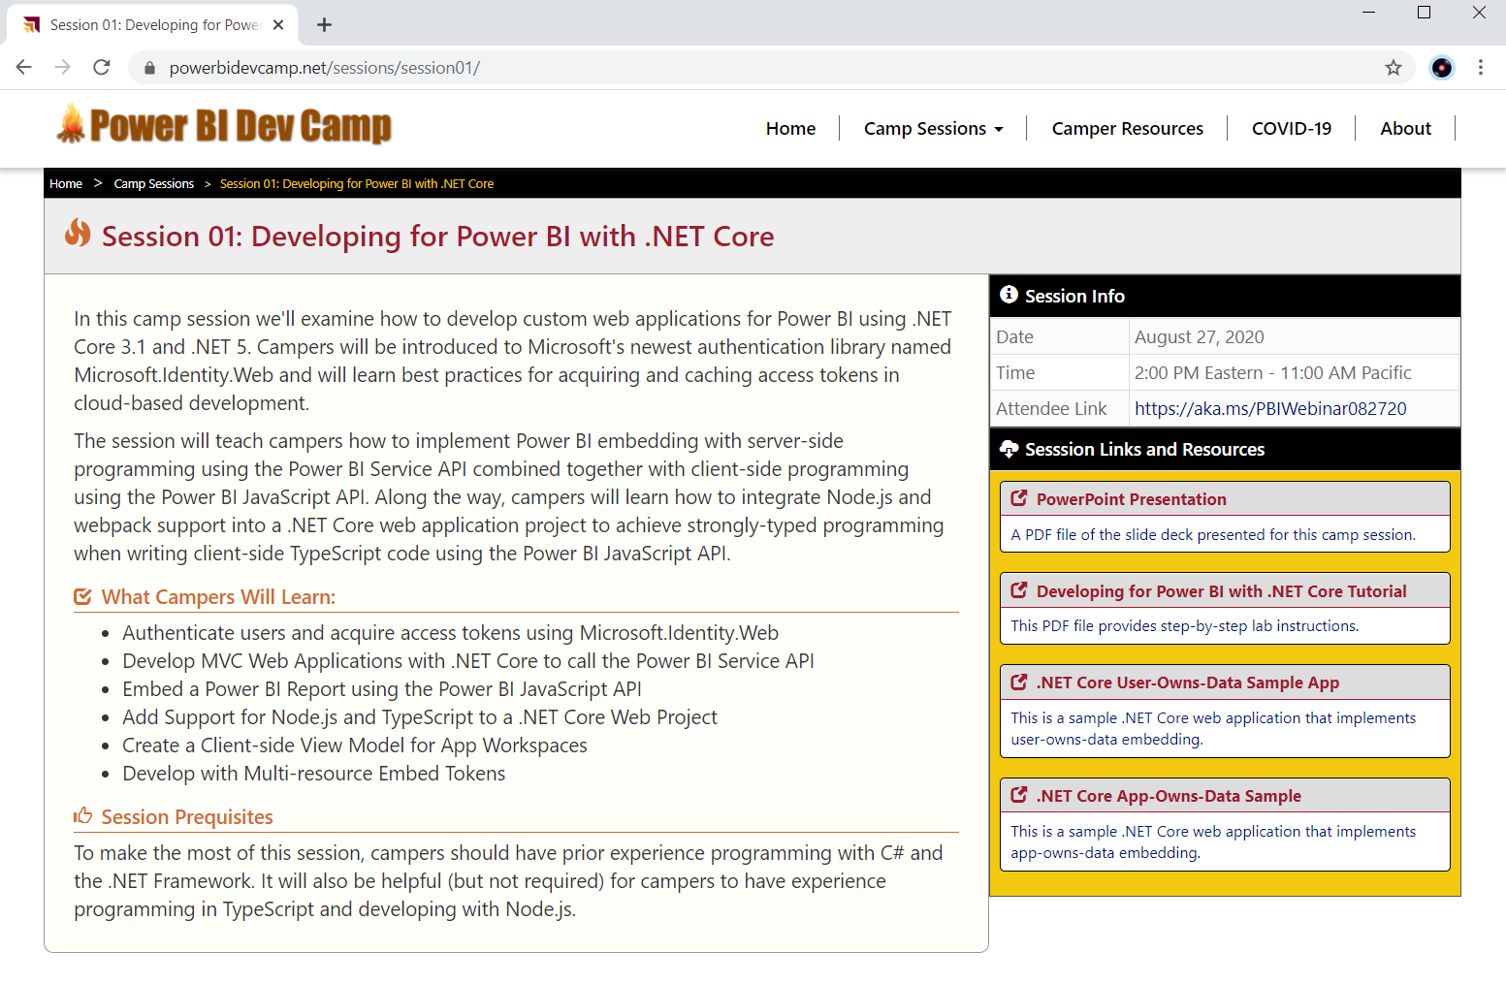
Welcome to Power BI Dev Camp
Power BI Dev Camp Portal - https://powerbidevcamp.net

Slide 4
Agenda
Review of PowerShell Fundamentals
The Power BI Library for PowerShell

Slide 5
PowerShell Fundamentals
What is PowerShell?
A task automation tool with command shell and scripting language
Function are called cmdlets and follow Verb-Noun naming conventions
Libraries are cmdlets are called modules and can be installed as needed
Essentials
Object-based script language
Tab Completion
Pipelining

Slide 6
PowerShell Versions
PowerShell 5 (aka Windows PowerShell)
Comes as part of Windows
Included as part of Windows Management Framework 5
Script authors can use PowerShell Integrated Script Environment (ISE)
PowerShell 7 (aka PowerShell Core)
Introduces cross-platform support for Linux and Mac
Script authors can use Visual Studio Code with PowerShell Extension

Slide 7
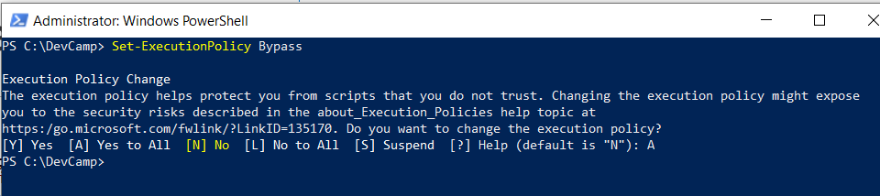
Set-ExecutionPolicy
PowerShell execution policy controls what scripts can run
Default policy does not allow scripts to run if they are not digitally signed
You must call Set-ExecutionPolicy to allow unsigned scripts to execute

Slide 8
What PowerShell Script Editor Should I Use?
PowerShell Integrated Scripting Environment (ISE)
Sss
Visual Studio Code

Slide 9
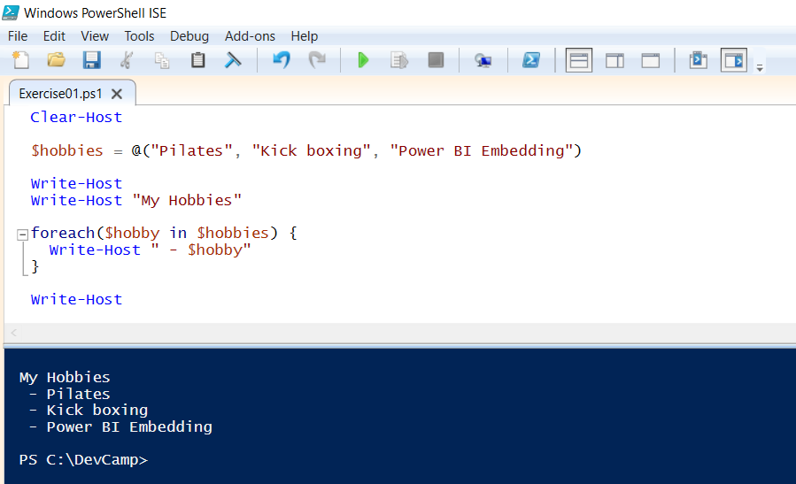
PowerShell Arrays and Enumeration

Slide 10
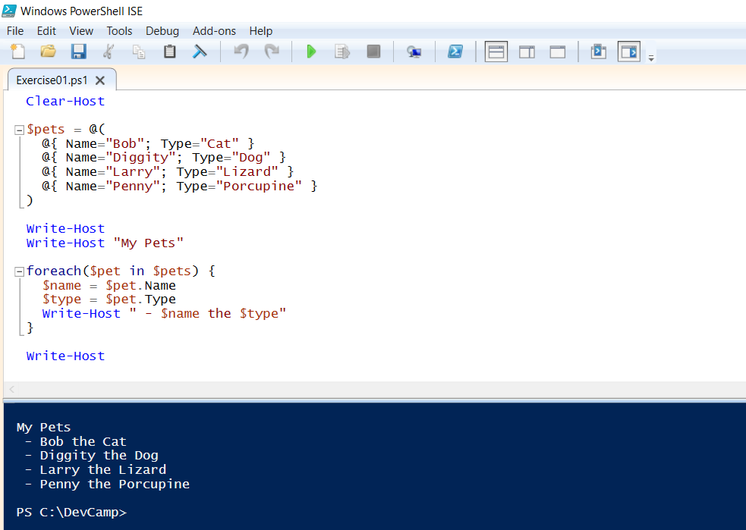
Dictionaries as Objects

Slide 11
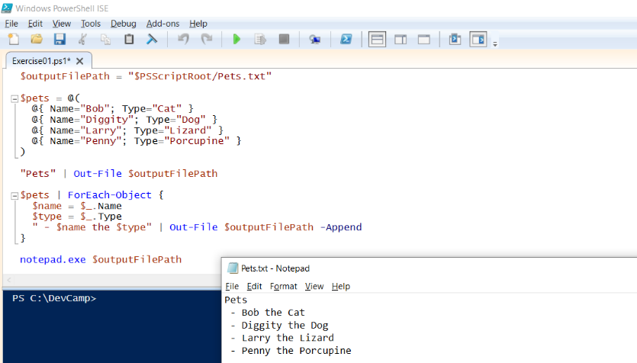
Writing Output to a Text File

Slide 12
Agenda
PowerShell Coding 101
Power BI Library for PowerShell

Slide 13
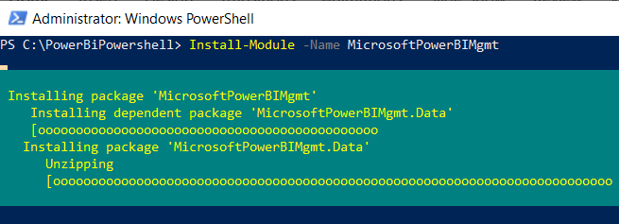
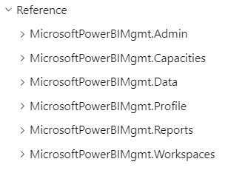
Installing Power BI Cmdlets for PowerShell
Must be installed locally on your computer
https://docs.microsoft.com/en-us/powershell/power-bi/overview
Install-Module -Name MicrosoftPowerBIMgmt

Slide 14
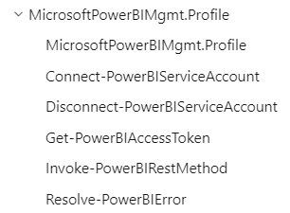
Connection and Profile Cmdlets
Connect-PowerBIServiceAccount used to establish authenticated connection
ddddd

Slide 15
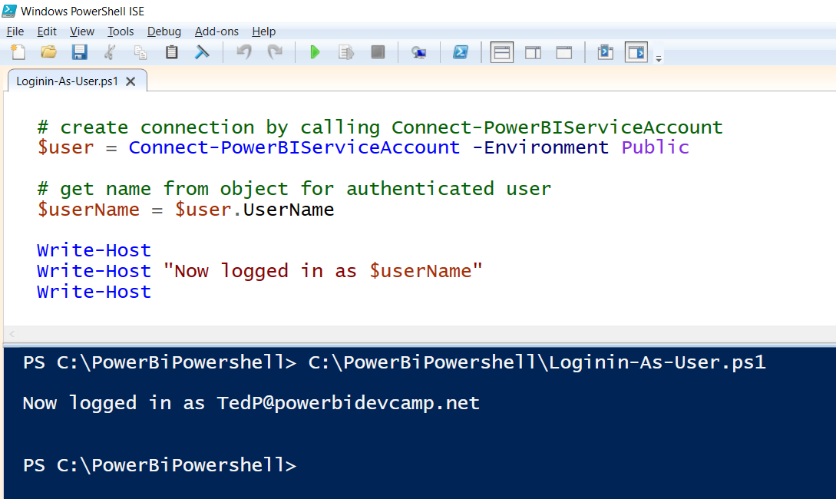
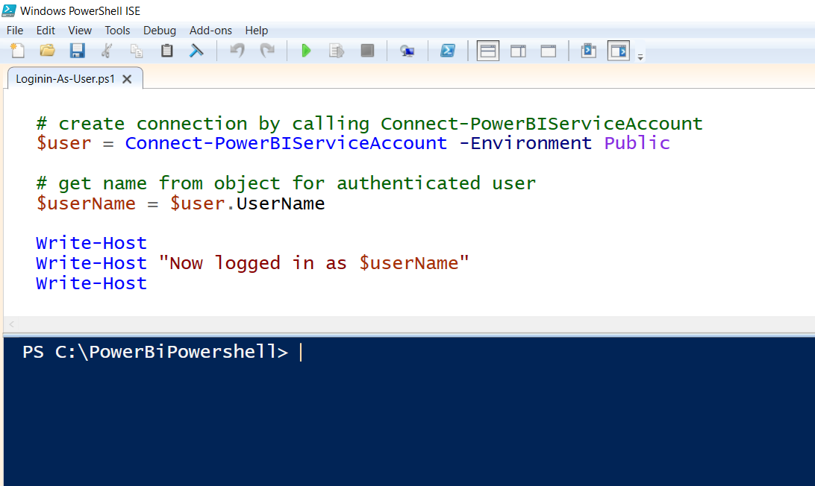
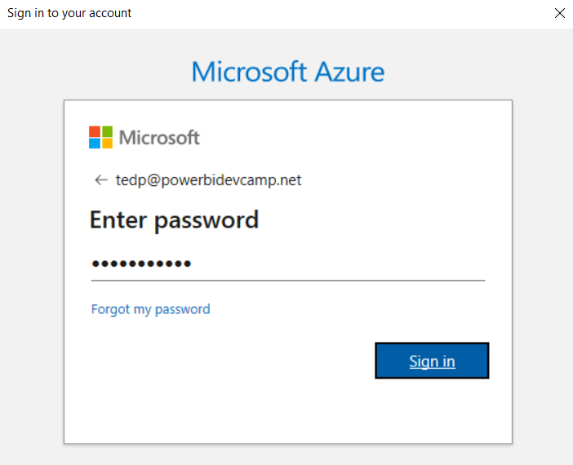
Calling Connect-PowerBiServiceAccount

Slide 16
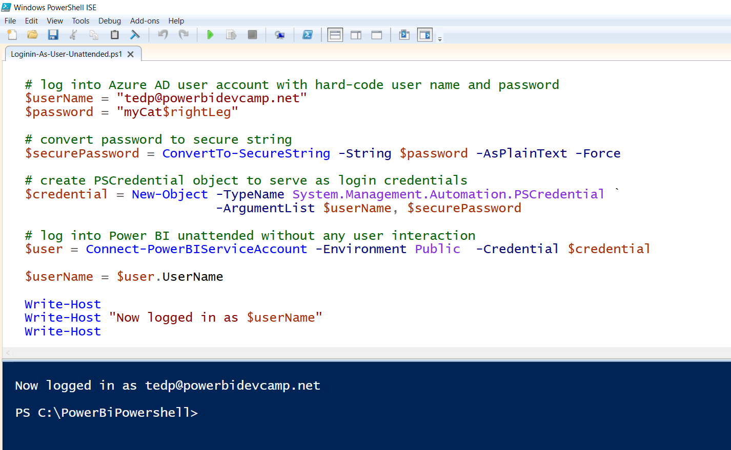
Writing Scripts with Unattended User Login

Slide 17
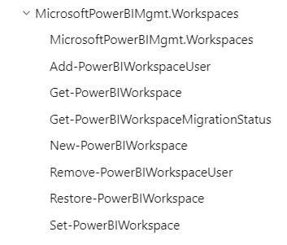
Workspace Management
Creating workspaces
Adding workspace users

Slide 18
Get User Workspaces

Slide 19
Create Workspace

Slide 20
Individual Scope versus Organizational Scope
Scope can be set to Individual or Organizational
Individual operates against only workspaces assigned to the caller
Organization operates against all workspaces within a tenant
Organizational scope requires Power BI admin privileges
User must be Power BI Service admin or global tenant admin

Slide 21
Running at Organizational Scope

Slide 22
Get Admin Workspaces

Slide 23
Add-Workspace-Users

Slide 24
List Workspace Assets

Slide 25
Delete Workspace

Slide 26
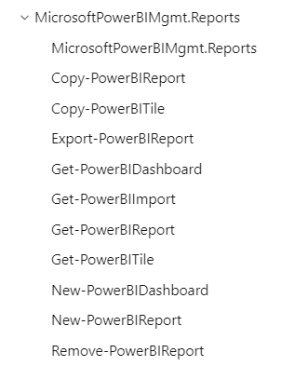
Content Management
Use New-PowerBIReport to publish PBIX file or Excel workbook
Use Export-PowerBIReport to export dataset and report to PBIX
Other cmdlets available to move and copy content across workspaces

Slide 27
Upload PBIX

Slide 28
Migrate Datasets Across Workspaces

Slide 29
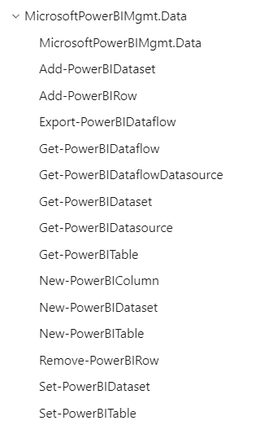
Data Management
Get dataset metadata
Create and populate streaming datasets
Export dataflow metadata

Slide 30
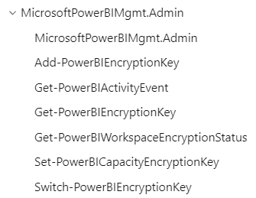

Administrative Cmdlets
Manage encryption keys
Export Power BI Activity Events
Get information about capacities

Slide 31
Update Credentials for Anonymous Access

Slide 32
Update Credentials for Azure SQL Server Database

Slide 33
Upload PBIX and Refresh Dataset

Slide 34
Connecting to Power BI using a Service Principal

Slide 35
Dataset Takeover by Service Principal

Slide 36
Camper Competition
Competition Rules
Build a .NET Core web application that extends User-Owns-Data tutorial
You must use Microsoft.Identity.Web for authentication
You must use TypeScript instead of JavaScript for client-side programming
Create a 3-5 minute video where you demo and describe your application

Slide 37
Questions

